Slide 1


INFOSYS INTERNSHIP PROJECT
PRESENTATION
COVERING THE INTERNSHIP UNDERTAKEN WITH
On
“X-RAY MEDICAL IMAGE CAPTIONING PROJECT”
FROM
25th MAY 2024 TO 19th JULY 2024
Submitted By
Mr. PRATIK .P. PARBHANE
MENTOR:- SUDHEER KUMAR

Slide 2

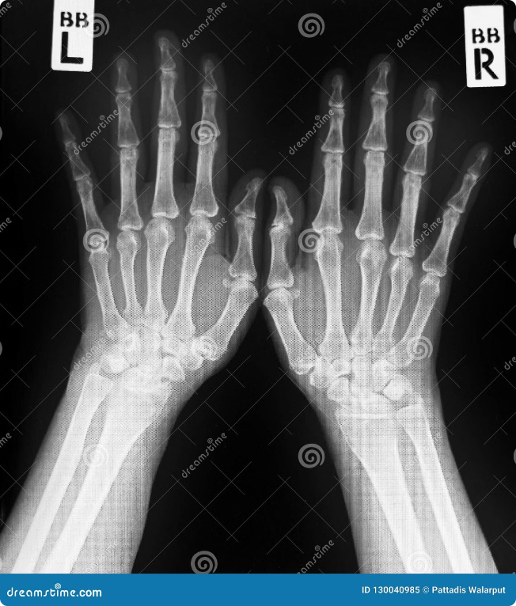
What is X-Ray Medical Image Captioning?
X-ray medical image captioning is a field of artificial intelligence that focuses on automatically generating textual descriptions of medical x-ray images. This technology aims to assist radiologists and other healthcare professionals by providing concise and informative summaries of the images, which can help in diagnosis and treatment planning. The process involves training machine learning models on a large dataset of x-ray images paired with their corresponding captions. These models learn to recognize patterns and features in the images and associate them with appropriate words or phrases. The generated captions can describe various aspects of the image, such as anatomical structures, abnormalities, and potential diagnoses.

Slide 3


Business Use Case
X-ray image captioning has several practical applications in healthcare settings. For instance, it can be used to automate the creation of radiology reports, which can save time for radiologists and improve efficiency in the diagnostic process. This technology can also be used in patient education, providing patients with a clear and concise explanation of their x-ray findings. Additionally, it can help in telemedicine applications, where remote healthcare professionals can access and interpret x-ray images more effectively. In research settings, x-ray image captioning can be employed to analyze large datasets of x-ray images, helping to identify trends, patterns, and potential new discoveries.
1
Automated Report Generation
X-ray image captioning can automatically generate initial reports based on the image, providing a starting point for radiologists to review and refine.
2
Patient Education
The generated captions can be used to create easy-to-understand explanations of the findings for patients, improving communication and understanding.
3
Telemedicine Support
X-ray image captioning can enhance telemedicine consultations by providing concise summaries for remote healthcare providers, facilitating quicker and more accurate diagnoses.
4
Research and Analysis
By analyzing large datasets of x-ray images and their captions, researchers can identify patterns, trends, and potential new discoveries.

Slide 4

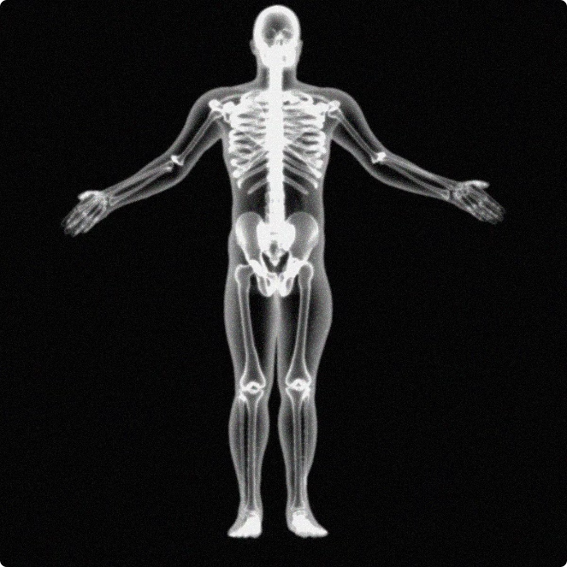
Importance
The importance of x-ray image captioning stems from its potential to revolutionize medical image analysis. This technology offers numerous advantages, including:
Improved Accuracy
By leveraging the power of machine learning, x-ray image captioning can improve the accuracy of diagnoses by providing comprehensive and detailed descriptions of the images.
Enhanced Efficiency
Automating the captioning process can save time for radiologists, allowing them to focus on more complex tasks and ultimately improving their productivity.
Reduced Errors
X-ray image captioning can help to minimize errors caused by human fatigue or oversight by providing consistent and accurate descriptions of the images.
Improved Patient Care
By enhancing communication and understanding between healthcare providers and patients, x-ray image captioning contributes to improved patient care and outcomes.

Slide 5

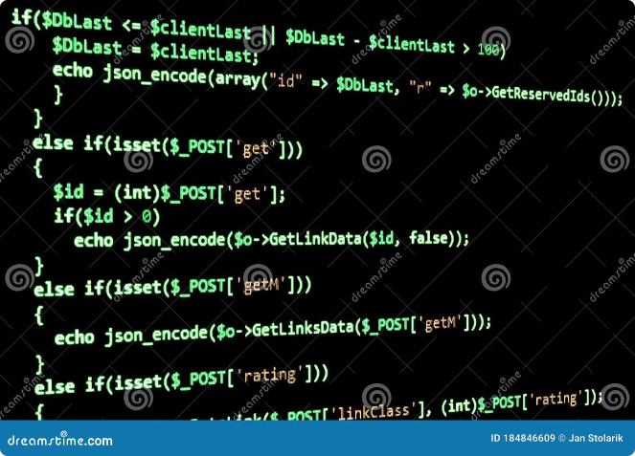
Text Preprocessing
Text preprocessing is a crucial step in the x-ray image captioning process. It involves cleaning and preparing the text data used for training the model. This stage is essential to ensure that the model can effectively learn from the data and generate accurate captions.
1
Tokenization
Breaking down the text into individual words or tokens is essential for the model to understand the language structure.
2
Lowercasing
Converting all text to lowercase standardizes the data and prevents the model from treating uppercase letters differently than lowercase ones.
3
Removing Stop Words
Words like "a", "an", "the" carry little meaning and can be removed to reduce noise and improve model efficiency.
4
Stemming or Lemmatization
Stemming reduces words to their root form, while lemmatization finds the dictionary form of the word, improving consistency and reducing variations.

Slide 6
Data Preprocessing
Data preprocessing is another essential step before building the model. This stage involves preparing and transforming the image and text data to make it suitable for training the machine learning model.
Image Preprocessing
Text Data Preparation
Data Splitting
Images are typically resized to a consistent dimension, normalized by subtracting the mean and dividing by the standard deviation, and augmented with techniques like rotation and flipping to increase the diversity of the training data.
The text data is often converted into a numerical representation using techniques like one-hot encoding or embedding. This allows the model to process and understand the text data.
The dataset is usually divided into training, validation, and testing sets. The training set is used to train the model, the validation set is used to evaluate the model during training, and the testing set is used to evaluate the final model's performance.

Slide 7

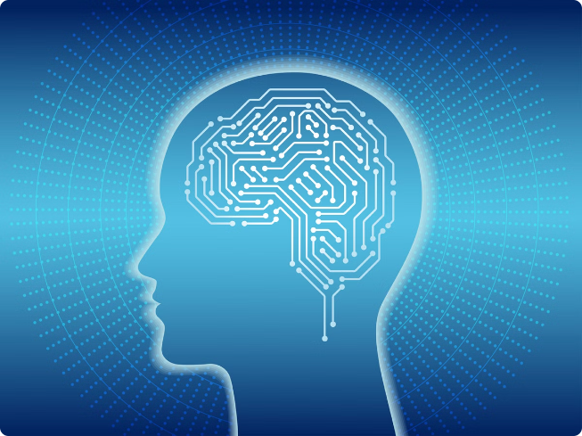

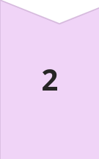

Model Building
The model building stage is where we use the preprocessed data to train a machine learning model to generate accurate captions for x-ray images.
Model Selection
Choose an appropriate model architecture based on the complexity of the task and the available data.
Model Training
Train the model on the preprocessed data, adjusting the model's parameters to minimize the error between the generated captions and the true captions.
Model Evaluation
Evaluate the trained model's performance on the validation and test sets to measure its accuracy, fluency, and relevance.

Slide 8

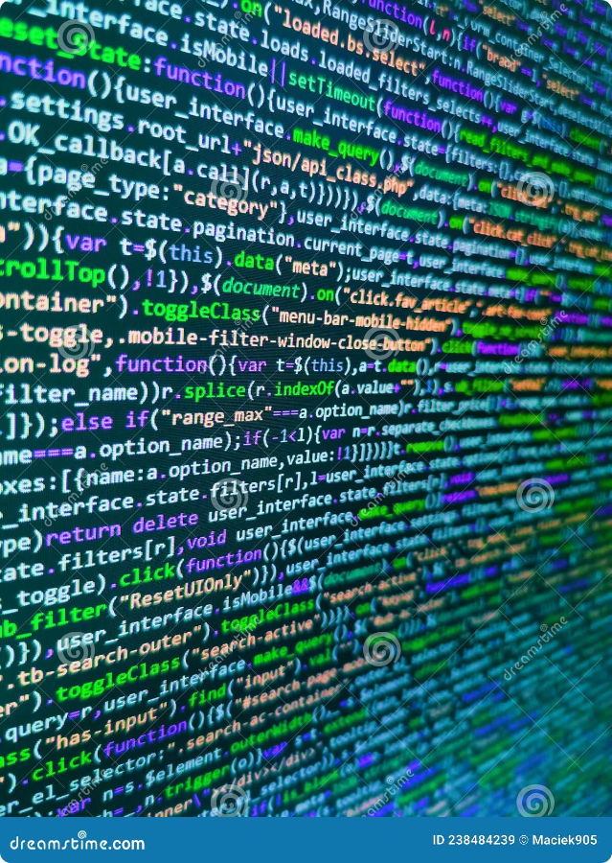
CNN + RNN
CNN + RNN is a common approach to x-ray image captioning. Convolutional Neural Networks (CNNs) are used to extract features from the image, while Recurrent Neural Networks (RNNs) are used to generate the textual description based on the extracted features.
CNN
RNN
Extracts features from the image
Generates a caption based on the extracted features
Captures spatial patterns and relationships in the image
Processes the features sequentially, learning the relationships between words in the caption

Slide 9


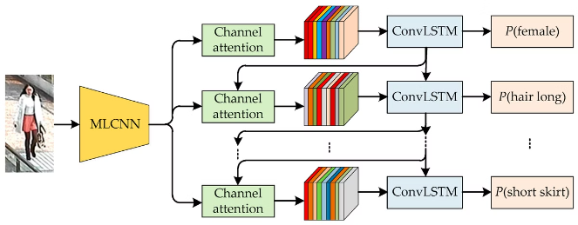


CNN + LSTM
CNN + LSTM is another popular approach, similar to CNN + RNN, but using Long Short-Term Memory (LSTM) instead of RNN. LSTM is a type of recurrent neural network that excels at handling long sequences of data. It is often preferred for captioning because it can capture dependencies between words in the caption more effectively than traditional RNNs.
Feature Extraction
The CNN extracts relevant features from the x-ray image, focusing on identifying crucial anatomical structures and abnormalities.
Sequence Modeling
The LSTM processes the extracted features sequentially, learning the relationships between words and predicting the next word in the caption based on the previous words.
Caption Generation
The LSTM generates a coherent and informative caption that accurately describes the content of the x-ray image.

Slide 10
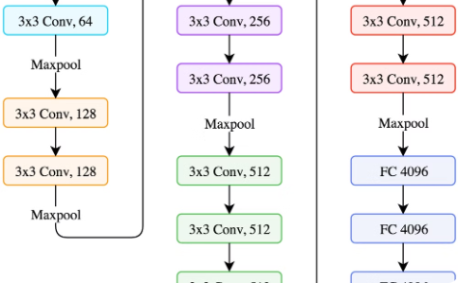
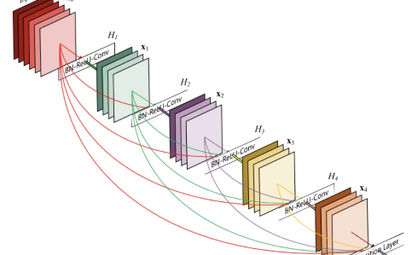
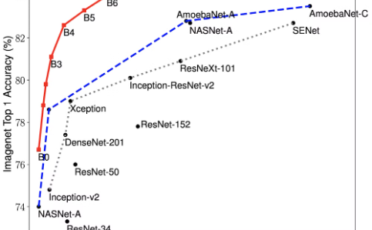
Pre-Trained Models
Pre-trained models, such as VGG, ResNet, and EfficientNet, have been trained on massive datasets of images. They have learned to recognize a wide range of visual features and can be fine-tuned for specific tasks like image captioning. This approach saves time and resources by leveraging existing knowledge and allowing for faster and more efficient model training.
VGG
ResNet
EfficientNet
A powerful convolutional neural network known for its simple architecture and impressive performance.
A deep residual network that allows for the training of very deep networks, addressing the vanishing gradient problem.
A scalable and efficient architecture that combines compound scaling and a novel activation function.

Slide 11
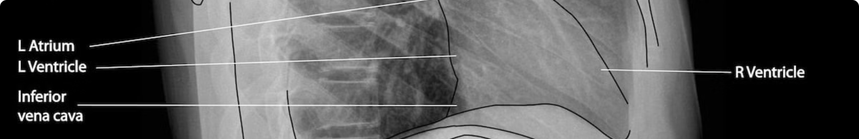
CONCLUSION
In conclusion, X-Ray Medical Image Captioning is a powerful tool that can significantly improve healthcare outcomes. By automating the process of describing medical images, this technology can save time for busy clinicians and provide valuable insights to support diagnosis and treatment decisions.
The key steps in implementing this technology include text preprocessing, data preprocessing, and building a deep learning model that combines convolutional neural networks (CNNs) and recurrent neural networks (RNNs) or long short-term memory (LSTMs). Pre-trained models can also be leveraged to accelerate the development process.
As the field of medical imaging continues to advance, X-Ray Medical Image Captioning will play an increasingly important role in enhancing patient care and streamlining clinical workflows. By embracing this innovative technology, healthcare organizations can unlock new opportunities to deliver more accurate, efficient, and personalized medical services.
X-ray medical image captioning is a rapidly developing field with the potential to significantly impact healthcare. It promises to improve diagnostic accuracy, enhance efficiency, and ultimately improve patient care.

Slide 12
THANK YOU!

